Slide 1

Mini Project-I (K24MCA18P)
Odd Semester Session 2024-25
Clean water Better Life
Riya Gaurr (2426MCA212)
Priyanshu Asthana (2426MCA1495) Shadab Idrishi (2426MCA208)
Project Supervisor: Ms. Divya Singhal Designation

Slide 2
















Content

Slide 3
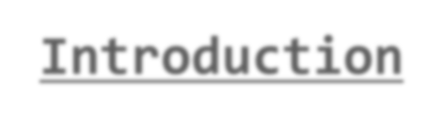

Introduction
CLEAN WATER BETTER LIFE
The sixth sustainable development goal, Clean Water and Sanitation, is to ensure that everyone has access to safe, clean water. Everyone has the right to healthy, adequate, physically accessible and affordable water for household use under the right to water security. Everywhere it is needed to be clean and pollutant free environment, so everyone can have better life.

Slide 4
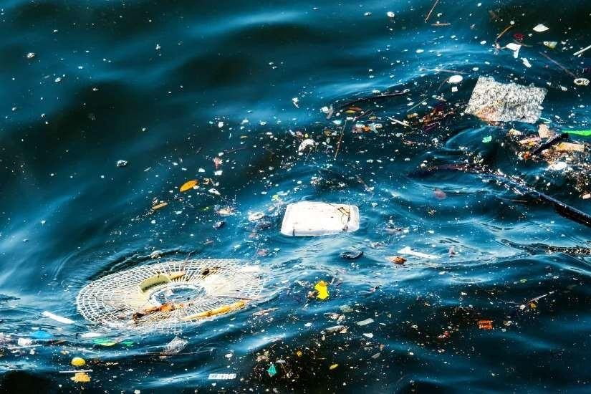
Literature Review
IMPORTANCE OF CLEAN WATER AND SANITATION:
Global monitoring report on water supply and sanitation.
Safe drinking water: The human right to clean water.
GLOBAL WATER CRISIS:
The united nation world development report.
A shared responsibility.
THE IMPACT OF UNSAFE WATER AND POOR SANITATION:
o Water, sanitation and hygiene(WASH) in Healthcare Facilities.
Literature review explores the key academics, institutional And policy-related publication that will inform the development Of Clean Water and Sanitation.
o Water Related Disease: Environment and Public Health Perspective.

Slide 5
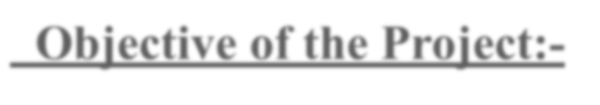

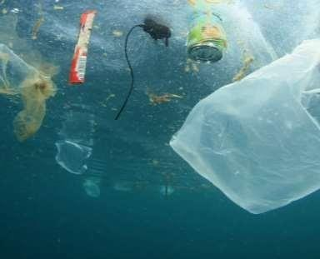



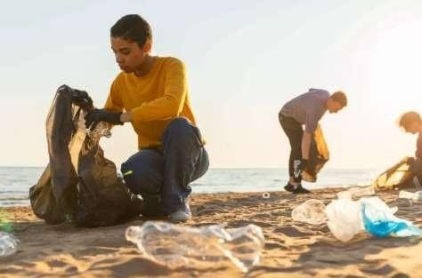
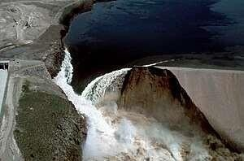

Objective of the Project:-
RAISE AWARENESS
Provide Information and Resources
Promote Sustainable Solutions
Facilitate Collaboration
Encourage Action

Slide 6
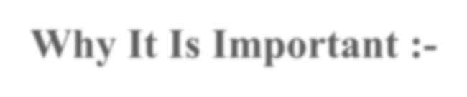

Why It Is Important :-
Providing Practical Solutions :
The webite will offer easy to follow guidelines for conserving water at home, schools, and workplaces, encouraging sustainable practices.
Connecting Users To Resources :
Access to tools and calculators : Interactive tools such as a water footprint calculator can help individuals and organizaton track and reduce their water usage.
Helping with Disaster and Crisis Management :
Emergency water solutions : Provide informations on emergency clean water solutions to help people during natural disasters or humanitarian crises where clean water access is distrupted.

Slide 7
Technology (Hardware Requirements)
Development tools
System Specifications
IDE(Vs code)
Git for version control(optional)
CPU : Dual-Core Processor(Intel i3)
Operating System: Window 10
Ram : 8Gb
Storage: 256 SSD

Slide 8





Technology (Software Requirements)
Front-end requirements:
Html
Css
Javascript
Backend – Requirements:
Php (Server side processing)
Database :
Xampp Server (inbuilt database with php)
EmailJS library:
Used EmailJS library to directly send mail to the admin.

Slide 9
Modules
1. Pollution Report:
This module allows users to report issues related to water quality in their area. It features a simple web form where users can enter information such as location, type of issue (e.g., contamination, odor,AQI value), and any additional comments. The data collected can help local authorities address water quality concerns effectively.The collected data will be directly sent to the email id of the admin of the website.
2. Water Quality Caculator :(with graphical representation)
A user-friendly web application that helps individuals estimate their daily water quality. Users can input data about their tds value ,pf, sulphur value to see their water quality graph and data. The tool provides personalized tips for reducing water usage and promoting conservation.

Slide 10
3. Locate Nearby Clean Water Sources (Including Live Feed):
This module displays a basic interactive map highlighting clean water sources in a state by navigating to the google map using the longitudinal and latitude value, Users can view locations and get basic information about water availability in their community. It helps raise awareness about local resources.(we are woking to enhance this by taking it to district level and into block level.)
4. Water Quality(based on TDS value):
The water_quality_checker module is designed to assess the water quality based on the Total Dissolved Solids
(TDS) value provided by the user. TDS is a key parameter in evaluating the purity of water, where higher values
may indicate contamination. This module helps to categorize water as safe for consumption or potentially unsafe by
comparing the TDS level to recommended standards.

Slide 11
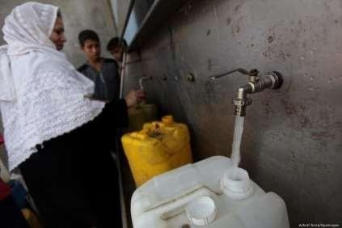
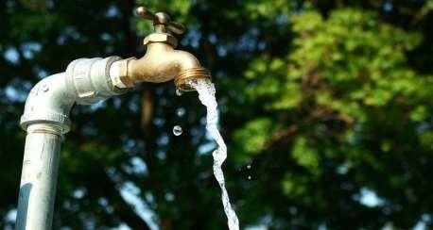
Modules (Contd.)
Feedback Form :
This module consists of a straightforward feedback form that allows users to share their experiences regarding local water supply services. Users can provide information about service reliability, quality, and any issues they face. The collected feedback can be used to improve water supply management and responsiveness to community needs.
This Photo by Unknown Author is licensed under CC BY
This Photo by Unknown Author is licensed under CC BY-SA-NC

Slide 12
Workflow/Gantt Chart
User Interaction:
Users enter data into web forms (water quality, water usage, feedback).
Processing:
Data is processed on the server (PHP) and stored in the XAMPP database.
Display:
Water sources and sanitation facilities are shown on an interactive map using API.
Reports:
Admins/local authorities can view reports to make data-driven decisions.

Slide 13
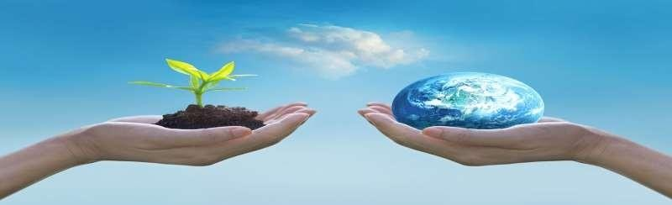
Reports
Water Quality Issues Reports: Data on water quality problems reported in different areas.
Water Usage Reports: Summary reports of water consumption patterns, identifying areas for conservation.
Community Feedback Reports: Insights into the quality of local water services based on user feedback.

Slide 14
References
WHO, UNICEF, Global Water Report 2023.
Technology for Water Management Solutions (Journal Articles).
Google Maps API Documentation.

Slide 15
Thank You

